Slide 1
Discourse Analysis
Why Does Discourse Analysis matters to Practice Research
Location
Name, Company
Date [month dd, yyyy]

Slide 2
General description
Discourses are
    the result of an articulatory practice and
    interrelated sets of texts that generate meaning and bring realities into being
    Discourse does not represent reality, but mediates/frames/constructs our understanding of reality

Slide 3
Basic assumption (1)
Social constructivistic
    By using language we construct and display our roles and/or identities
    Discourse does not represent reality, but mediates/frames/constructs our understanding of reality
      ‘Mind and reality are constituted discursively, rather than existing as an entity prior to and independent of language’ (Wood & Kroger)

Slide 4
Basic assumption (2)
Who’s talking?
  ‘We’ are embedded and an effect of discourses. We are subject and object of discourse
    Practice is a discourse, discourse is a (social) practice.
      Speaking is a way of doing things (performative) Promising, ordering, commanding
        I love/hate/dislike you/You’re lovely/a bastard
      Every description is performative

Slide 5
Basic assumption (3)
Discourse wield power
    ‘Discourses contribute centrally to producing the subjects we are, and the objects we can know something about (including ourselves as subjects)’.
  Discourse helps to sustain and reproduce the social status quo
  They can help to produce en reproduce inequal power relations.
Central research question:
    How is the social world, including its subjects and objects, constituted in discourses?

Slide 6
Central research question:
How is the social world, including its subjects and objects, constituted in discourses?
It points to
    the ways certain practices serve to obscure and therefore perpetuate what is taken for granted
    the historical and cultural specificity (the particular)
    the link between knowledge and social practice

Slide 7
Practice Based Articulation
    DA is a critical reflection upon prevailing ways of articulation
    DA shows how we take part in the process of articulation as subject and as object
    DA aims at making differences and challenges the thinking in oppostions/exclusions/classifications
Notes:
In general
DA is not concerned with evidence based practice, on the contrary. It could be considered as an particular form of practice based evidence: practice based articulation.
DA considers practices as result of different ways of articulation.
In term of the Salesbury statement DA is practice-minded research of articulations which emerges directly from the complex practices. For this reason it is essential to study how articulations result in certain practices, what this involves and how we take part in this as subject and as object
What does this practice based articulation aim?.
1 Critical reflection upon prevailing way of articulating
It can make us aware of the mechanisms through which a particular meaning becomes hegemonic.
In policy texts value assumptions are often presented as existential assumptions or as something that is taken for granted. DA can disentangle these different assumptions.
By criticizing the taken for granted is can leave space for other articulations, that is to say for other possibilities.
2. We take part in this articulation as subject and object
It is not a question of being for or against self-reliance.
DA shows the complexity of us taking part as subject and object in the process of articulation. We can not just leave the principle of self-reliance behind us. This is important to understand the dilemma’s we encounter and to understand the inconsistencies we see sefl-reliance is articulated
3. Opposition – difference
In continutation with point 2>
Thinking in oppositions as self-reliance vs dependency, viogours vs. vulnerable make us blind for complexity of paradoxes and paradoxical subject positions.
We are inclined to make a consistent story of our reality, but if we look closer the discourse of self-reliance betrays many inconsistencies.
Vulnerable people who are fantastically self-reliant’
Concept who seem to exclude each other: self-reliance does not exclude dependency: without dependency we can not be self-reliant, for exemple a notion as ‘relational autonomy’

Slide 8
Practice Based Articulation
    DA can make explicit the different ways of articulation of policy making and the practice of social work
    DA it can make explicit the intuitive or implicit deconstructions of the prevailing articulation of their profession
    DA can indicate news articulations of meaning
Notes:
4. It can make explicite the struggle between differents ways of articulation;
that is to say the gap between the world of policy and the daily experiences of social workers. It can describe how policy develops in the practice of social workers. DA can argue that other ways of articulation are as valid as the prevailing way.
5. As we experience during the group conversations social workers deconstruct the prevailing assumptions and way of representing the social reality of clients and their own profession. But these deconstructions are intuitive and remain implicit. DA can made these intuitive explicit and demonstrate the in consistencies of the prevailing way of articulation.
During the group conversations social workers were quite cynical about policy as wel as clients. May be cynism result form the incapacity to intervene in the prevailing way of articulation.
By making the process of articulation explicit DA can turn this cynism in a critical commitment to the principle of self-reliance.
6. New/other articulations
those who articulate social problems in other words are often not taken serious, rather they are considered old-fashioned
rasing objections is not enough, because they still are framed by the dominant discourse
so we have to indicate new articulations and take them serious, make them explicite.
because new articulations mean new practices and possibilities.

Slide 9
Universalization of the Particular
‘The universal is no more than a particular that at some moment has become dominant’ (Ernesto Laclau)
Achieving hegemony consists in hiding the process of universalization as if self-reliance speaks for itself
This universalization is crucial for the depolitization: its coverts that self-reliance is a political concept
Notes:
Common statements claim universality.
Note we are dealing here with a principle, not with de result of empirical research which proves that every citizen wants to be self-reliant.
Universality is empty
Only because it is empty and remains untainted by any particular historical or cultural meaning, a principle can be universal.
But if it remains empty it will remains meaningless for us. It has te be filled.
This implies a very complex logic of supplementarity. I can not elaborate on here.

Slide 10
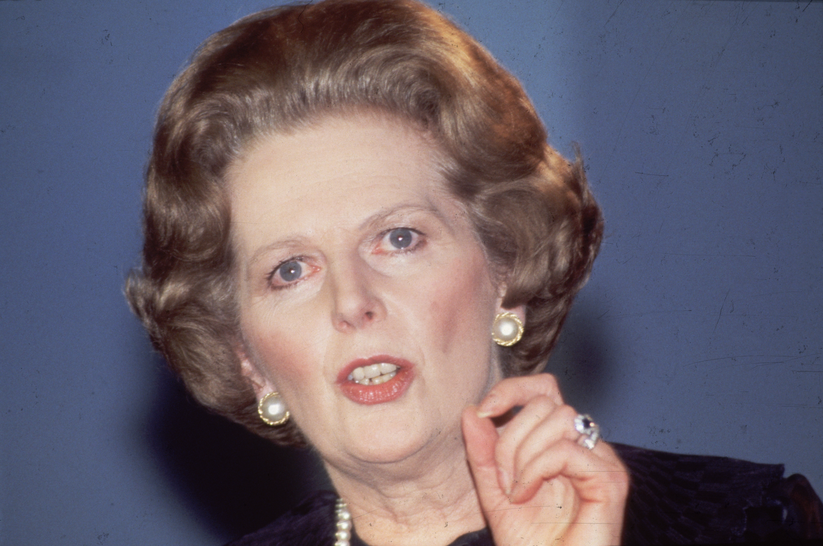
‘There is no alternative’
Policy texts can be seen ‘to limit policy options by portraying the socio-economic order as simply given, an unquestionable and inevitable horizon which is itself untouchable by policy […]’ Norman Fairclough
Notes:
If we look into policy texts we see:
a depolitization of the ideal of autonomy and self-reliance. The government withholds itself from a substantive determination of meaning of live. The retrenchment of the welfare state is connected with a post-politics of liberal democracies
not ideologies but a Realpolitik of unintended results is leading. Policy is based upon scientific social research, positivistic approach
moral and the cautionary tale: bad things will happen if we do not implement the inevitable.
policy makers and politicians present themselves as the spokesman of reality

Slide 11
Discursieve figures (some among many)
  Moral tale
  Cautionary tale
  Creation of antagonism
  Existential/propositional, value assumptions
  Nominalization: processes ‘without human agents’
  No ‘explanatory logic’

Slide 12

Niemand wil immers afhankelijk zijn!
Wie wil er nou niet zelfredzaam zijn?
Universele claim
Dat spreekt vanzelf/natuurlijk
Duldt nauwelijks tegenspraak
Stilzwijgende censuur

Slide 13
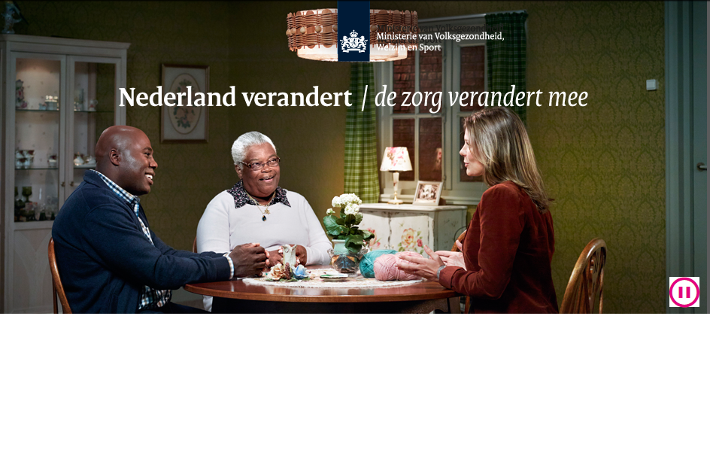

Slide 14


